Slide 1
Math 152 – Lesson 17
Lesson | Topic | Reading
15/16 | Work/Ave Value of a Function | 6.4/6.5
17/18 | Applications to Physics & Eng | 8.3
19 | Modeling w/ Diff Eq/Dir Fields | 9.1/9.2
Objectives:
Compute hydrostatic pressure and force at a fixed depth

Slide 2
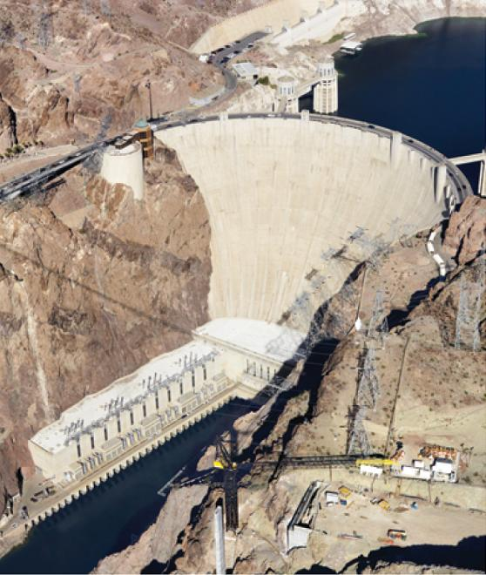
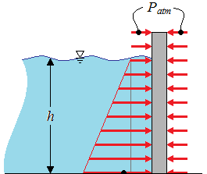
Hydrostatic Pressure
F = m * a = m * g
m = density * volume = desity * A * depth
F = density * A * depth * g
P = F/A = desity * g * depth
(pressure is the same in all directions)
P

Slide 3
Dam Calculus
A dam has the shape of the trapezoid shown. The height is 20 m and the width is 50 m at the top and 30 m at the bottom. Find the force on the dam due to hydrostatic pressure if the water level is 4 m from the top of the dam.
Notes:
46x^2/2-x^3/3
27x^2-x^3/3-200x
Force = (pressure(N/m^2))(area(m^2))
Method 1) h=0 for the surface of the water
A = (46 – h)dh (use similar triangles)
P = (density)(g)(h)
Method 2) h starts at the top of the wall
A = (50 – h)dh
P = (density)(g)(h - 4)
Method 3) measuring “h” from the bottom of the dam
D = 16 – h, L = 30 + h
F = ρgʃ(16 – h)(30+h)dh
ALL yield “ρg(4522.67) N”, or 44.322e6 N

Slide 4
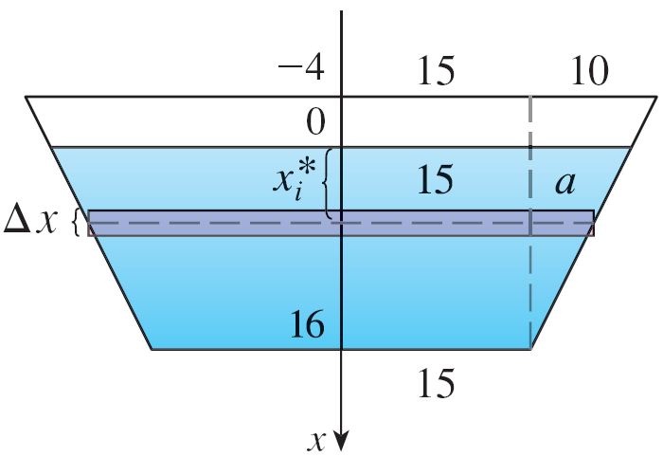
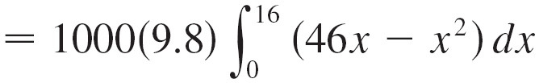
Solution
A = width deltaX
F = P * A = 1000 g x width deltaX
width = 30 + 2 a
= 30 + 2(0.5(16-x))
= 46 - x

Slide 5
Desk Work
Find the hydrostatic force on one end of a cylindrical drum with a radius of 3 ft if the drum is submerged in water 10 ft deep. Setup but do not solve.
3 ft radius
10 ft
Notes:
Solution: (in the book)
Put coordinate system at center of drum.
A = w * deltaY = 2*x*deltaY = 2* sqrt(9-y^2) * deltaY
depth (d) = 7 – y
F = P * A = 62.2(7-d)(2 * sqrt(9-y^2) * deltaY)
Integrate from -3 to 3 (edges of the barrel)

Slide 6
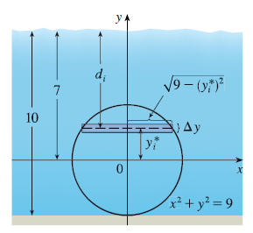
Solution
Solution:
Put coordinate system at center of drum.
A = w * deltaY = 2*x*deltaY = 2* sqrt(9-y^2) * deltaY
depth (d) = 7 – y
F = P * A = 62.2(7-d)(2 * sqrt(9-y^2) * deltaY)
Integrate from -3 to 3 (edges of the barrel)
Drum is a circle with an equation of: x^2+y^2 = 9
Its radius in the x-dir is: x = sqrt(9-y^2)

Slide 8
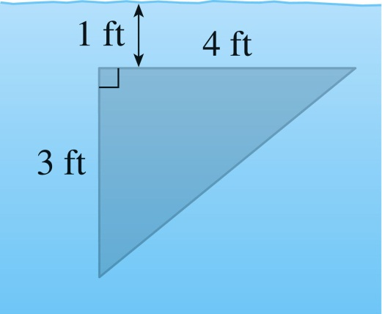
Board Work
A vertical plate is submerged in water. Express the force as an integral and evaluate it.
A cube with 20-cm-long sides is sitting on the bottom of an aquarium in which the water is one meter deep. Estimate the hydrostatic force on (a) the top of the cube and (b) one of the sides of the cube.
What is the total force on the bottom and each side of a rectangular water tank that has length 20 ft, width 10 ft, and depth 15 ft. If the tank is full, how much work does it take to pump all the water out?

